Slide 1

Experimentation at Uber: The Optimal Strategy
By Olivya Pastis

Slide 2
Overlying Question
Should Uber maintain the standard wait time at two minutes or increase wait times to five minutes in additional cities not included in the original Boston synthetic control experiment?

Slide 3
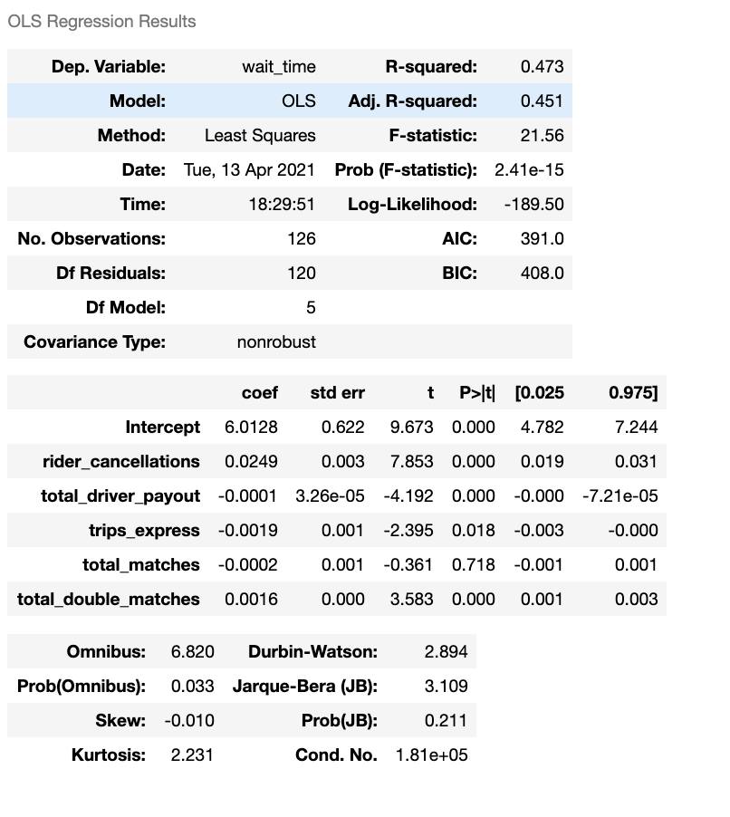
OLS Regression Results
Vast majority of the p-values are statistically significant at the 95% confidence level
Low standard errors

Slide 4
Difference in Express Trips
Higher amount of Express POOL trips with a 2 minute wait time
Results in lower rider prices

Slide 5
Disparity in Total Matches
Total double matches are substantially higher for a wait time of 2 minutes
Brings about a higher driver payout
Lowered costs per ride

Slide 6
Effects of Wait Times on Matches
Total matches is significantly higher for 2 minute wait time
Substantial difference in total matches between the 2 minute and 5 minute wait time

Slide 7
End Result
Do not increase the wait times from 2 to 5 minutes

Slide 8
Limitations
Experimentation can lead to a risk of contamination and spillover effects
Small sample size
Limited variables

